Slide 1
Eppstein’s Algorithm
File
Multiple Shortest Paths Graph Algorithm
April 28th
Gavin Crigger, Tao Groves, Matthew Lucio, Justin Park
Notes:
JUSTIN

Slide 2

File
Multiple Shortest Paths Graph Algorithm
April 28th
Problem statement
Given graph G = (V,E), number k, and vertices S and T, find and return the k unique shortest paths between vertices S and E.
S
3
V₂
2
m = |E|, n = |V|
1
5
V₅
V₇
1
V₁
1
V₄
Naive approach: modified Dijkstra's, visiting each vertex at most k times.
Runtime = O(knlog(kn))
2
6
T
5
2
V₃
V₆
4
5
Notes:
JUSTIN - go through full example (note each change in the animations), how djikstra’s can be quickly modified to match this, and a brief motivation (where can this be applied?)
Let’s say that you’re maybe running a shady criminal organization where you might be moving suspicious individuals from one island to another, but you don’t want them to take the same
path since that’s to
Let’s say k = 2, our first exploration is a simple dijkstra algorithm, where the path is s —> v1 —> v2 —> v4 —> v5 —>v7 —> t
Then, we explore each of those nodes a second time (yellow), observing the paths from each of those nodes we did not take
The next
K = 2

Slide 3
File
Multiple Shortest Paths Graph Algorithm
April 28th
2
How can we improve this?
Taking me makes your path weight 16 instead of 14!
Find a way to construct a new graph from the input graph such that each edge popped from our min-heap represents the next shortest path - every pop is a path!
Eppstein’s proper constructs this graph in O(m + nlogn) time, and the following k pops run in O(k) time, giving a total runtime of O(m + nlogn + k).
Key concept: sidetrack edges
Given the optimal path from S to E, sidetrack edges represent deviations from the optimal path. They are weighted by how much the total path weight increases from the optimal path by taking that edge.
Notes:
TAO - highlight the fact that we go from popping multiple times to reach the terminal node to popping once and getting a path every pop

Slide 4
File
Multiple Shortest Paths Graph Algorithm
April 28th
Sidetrack graph example
Sidetrack graph G’
Edge weight: sidetrack(u, v, w) = w + d_{v} - d_{u}, where d_{l} represents the weight of the optimal path from vertex l to T.
S
G = (V, E)
T
4
(V₃, S, 4)
V₃
3
2
(V₂, V₃, 3)
5
(S, V₁, 1)
V₂
V₃
3
V₁
3
V₁
(V₁, V₁, 3)
2
(V₂, V₃, 3)
1
S
V₂
All sidetrack edges on the path from a node U to end node T are considered directly connected to U.
Notes:
TAO - walk through example, be sure to explain how the two text boxes apply here (particularly how all edges on the path from U to T are directly connected to U, like V₂, V₃, 3 being connected to S in G’)

Slide 5
File
Multiple Shortest Paths Graph Algorithm
April 28th
Reconstructing paths from single sidetrack edges
P_{v3}
T
4
V₃
The use of implicit path representations is key to Eppstein’s algorithm achieving its quick runtime - each popped sidetrack edge can be used with precalculated values to find the explicit path.
We use Dijkstra's on a reversed G to set up the d_{u} values and optimal paths p_{u} for each vertex. Thus, we can take sidetrack edge (u, v, w) and paths p_{u}, p_{v} to construct path p_{u} + (u, v, w) to p_{v}.
3
2
5
V₂
3
V₁
3
2
P_{v2}
1
S
Notes:
MATTHEW - re-iterate BRIEFLY that indirect representations are the only way to speed up runtime (1 pop 1 path), show how to go back to a full path representation quickly using our precomputed values. Be sure to mention that reverse Djikstra’s is what gives us the optimal path/weight for each vertex (essential for rebuilding path)

Slide 6
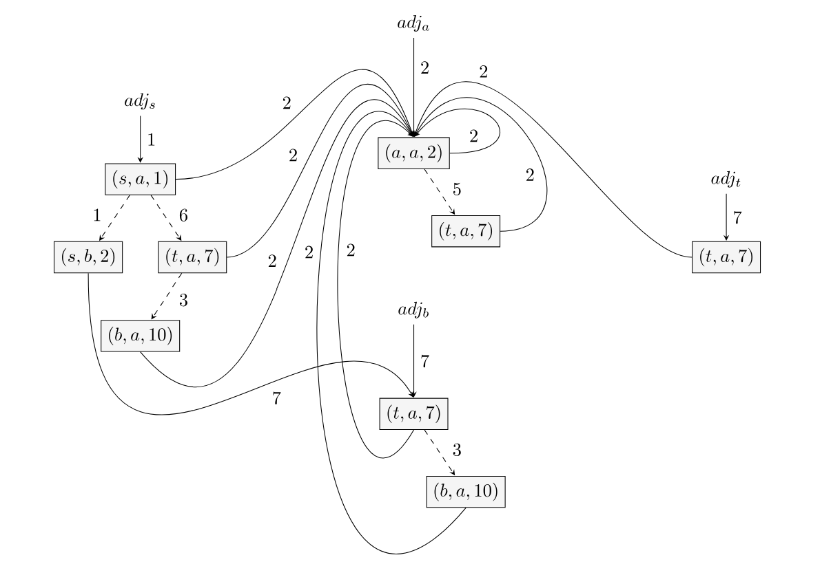
File
Multiple Shortest Paths Graph Algorithm
April 28th
Overall approach
Persistence omitted for simplicity!
1) Construct a graph that stores sidetrack edges as nodes and edge traversals as paths with sidetrack weights as path weights.
Built around using persistent heaps for each adjacency list adj_{u} in our graph, with path traversals connecting heaps.
2) Push the start node and its optimal path weight to a heap, then loop k times: popping from the heap, recording the implicit path representation, and pushing all neighboring sidetrack path weights and their vertices.
Notes:
GAVIN - summarize previous mentioned high-level concepts and how they connect to overall approach. First, use reverse djikstra’s and graph construction as a “precursor/setup” step that allows for quick popping. Then, go over start to and actual loop, mentioning how implicit paths come in and pointing out persistence as a tool for speed up (omitted for time/simplicity)

Slide 7
File
Multiple Shortest Paths Graph Algorithm
April 28th
Pseudocode walkthrough
G, s, t, k
T_{sp}
G
s, t
Eppstein’s algorithm (G = (V, E), s, t, k)
# graph construction
1 build reverse graph G_{r} from G
2 run Dijkstra's on G_{r}, s, t to find d_{u}, p_{u} for all vertices
3 construct shortest path tree T_{sp} from p_{u}
4 create min-heap H_{u} of sidetrack edges for all vertices
5 create result set R_{a} = d_{s}
6 create overarching min-heap Q_{p} initially with (d_{s}, H_{s})
# k-pop algorithm
7 while len(R_{a}) < k and Q_{p} is not empty
8 pop total cost, node from Q_{p}
9 add cost to R_{a}
10 push node’s outgoing edges to Q_{p}
11 return R_{a}
G_{r}
Djikstra’s
d_{u}, p_{u} ∀ u ⋹ V
return!
cost
R_{a}
d_{u}, p_{u}
outgoing edges
Q_{p}
H_{u}
cost, node
Notes:
GAVIN - be sure to click through slide animations as you explain, highlight the split in the algorithm between setup and k-pop, LEAVE TIME FOR RUNTIME PLZ

Slide 8
File
Multiple Shortest Paths Graph Algorithm
April 28th
Runtime analysis
O(m + nlog(n) + k)
1: Graph reversal / Dijkstra’s
2: G’ construction
3: k-pop algorithm
O(m + nlog(n))
Follows a well-documented, optimized Djikstra’s algorithm
O(m + nlog(n))
With persistent heaps, all edges are visited once and all vertices have logarithmic inserts
O(k)
We loop through a constant time algorithm until we reach k total paths accumulated
Notes:
MATTHEW - pretty much read from the slides - all of these boil down to the overall runtime. Review slide 7 to be prepared for any extra pieces you might need to explain

Slide 9
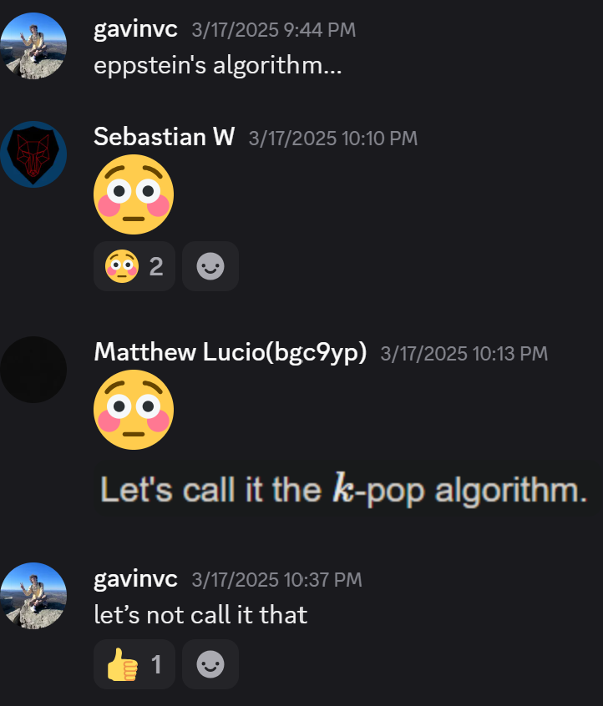
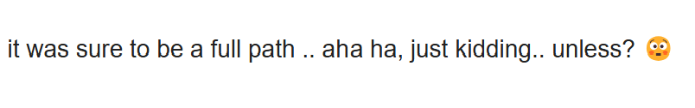
File
Multiple Shortest Paths Graph Algorithm
April 28th
Thank you!

